Slide 1
Overview of the NAVER Cafe SDK

Slide 2
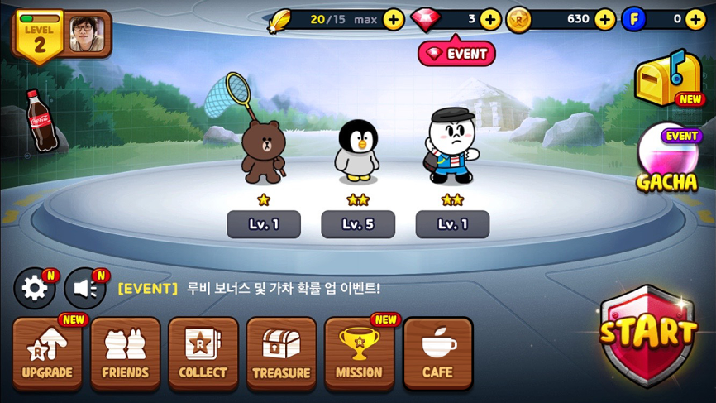
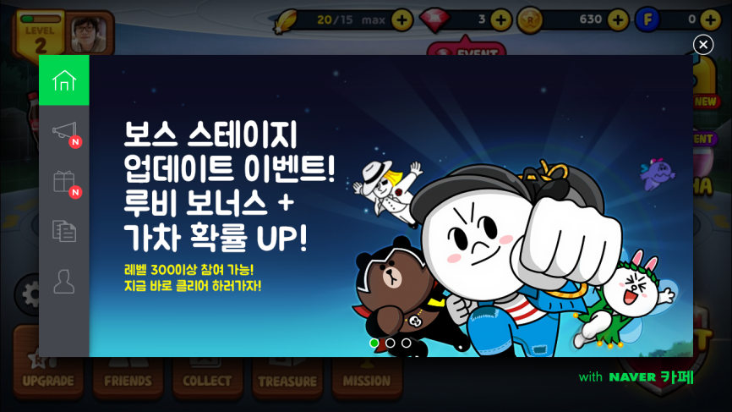

1. What is the NAVER Cafe SDK?
The NAVER Cafe SDK is a dedicated software development kit (SDK)
for mobile games, which lets mobile gamers use community features
(NAVER Cafe) without leaving games while they are playing

Slide 3
2. Characteristics
NAVER Cafe SDK enables community features to be implemented in games - Users don’t have to leave games to use the community features.
Lightweight forms focused on reading and writing, the essential features in online communities - We offer the absolutely necessary features for game and community users.
Using existing communities - You don’t have to invest your time in learning a new platform.
Ease of operation and maintenance - With the Community Settings page accessed from a computer, users can operate and manage it without difficulty.
Providing Home for displaying promotional content - Users can have a convenient place to display a promotional image or video.
Allowing direct uploads of screenshots or videos - With direct uploads, users can enjoy uninterrupted gameplay.

Slide 4

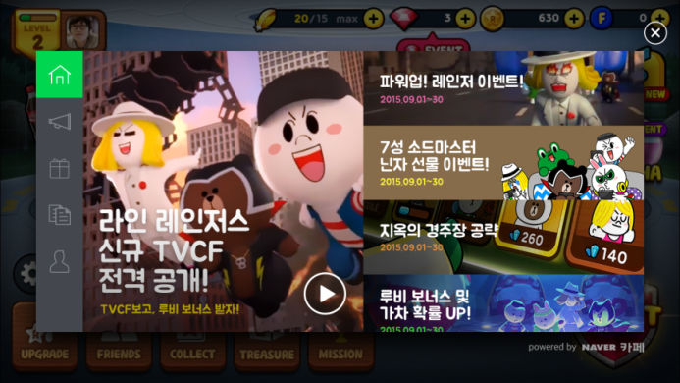
3. Home
Home
Full View
A place to display a full-sized image or video
Up to 3 pieces of promotional content available (swipe left or right)
Spilt View
Left
A place to display a medium-sized image or video
Only 1 piece of promotional content available
Right
A place to display a small-sized image
Up to 20 piece of promotional content available (scroll up or down)

Slide 5
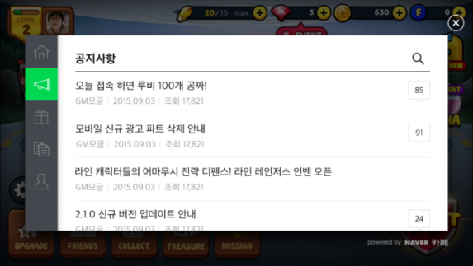
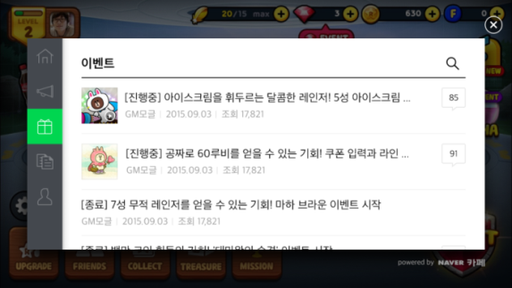
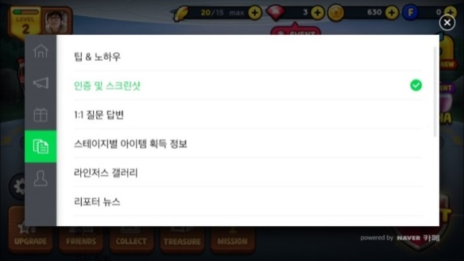
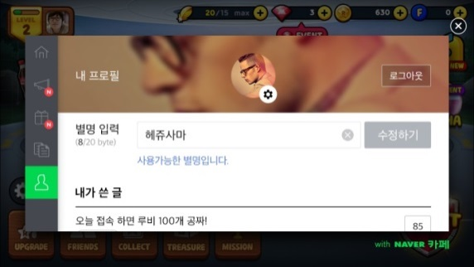
4. Menu
Menu
Notice
You can select one among various menus provided by the NAVER Cafe community
Displays a list of notices to users
Event
You can select one among various menus provided by the NAVER Cafe community
Displays a list of event announcements to users
Menu
You can display all menus provided by the NAVER Cafe community
You can specify which menus are displayed in the Community Settings page accessed from a computer
Profile
Personal profile
A user can join a community just by adding a nickname and later edit the nickname
Displays post list that the user has written
Notes:
‘게시판(또는 통합게시판)’은 ‘forum’으로 번역했다가 “네이버 카페 SDK 적용 가이드”에 ‘Glink.startNotice(), Glink.startEvent(), Glink.startMenu(), Glink.startProfile()’과 같이 쓰고 있어 ‘menu’로 수정했습니다. ‘forum’으로 수정해야 한다면 알려 주세요. (PPT와 Word 문서에 동일하게 적용했습니다.)

Slide 6
5. Home > Full View
A place to display an image or video
Up to 3 pieces of content available (swipe left or right)
Video plays in full screen mode
Clicking a banner will direct to a list of posts or execute game features

Slide 7
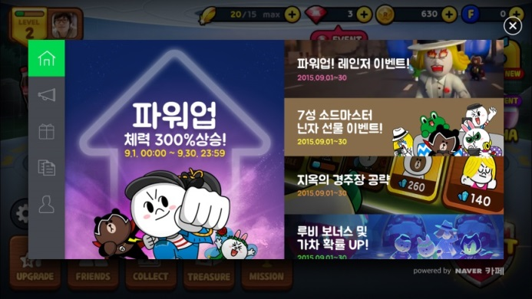
5. Home > Spilt View
A place to display an image or video
Up to 1 piece of content available
Video plays in full screen mode
Clicking a banner will direct to a list of posts or execute game features
A place to display an image
Up to 20 pieces of content available (scroll up or down)
Clicking a banner will direct to a list of posts or execute game features

Slide 8

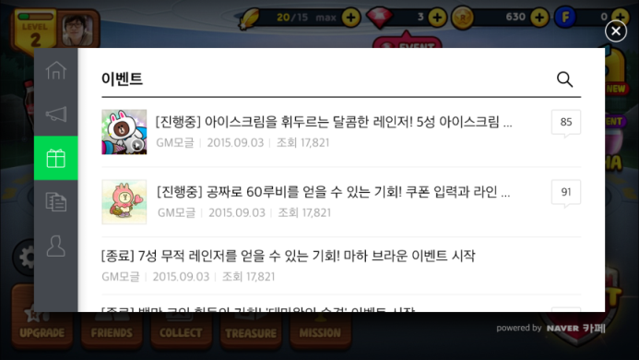
5. Tab > Notice and Event
Second and third tabs on the left
You can select one among various menus provided by the NAVER Cafe community
Recommend to use the Notice board and the Event board, respectively
Displays a list of posts on the corresponding menu

Slide 9

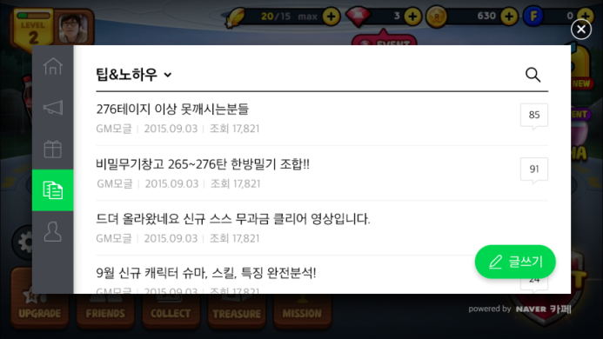
5. Tab > Menu
Fourth tab on the left
You can display all menus provided by the NAVER Cafe community
You can specify which menus are displayed in the Community Settings page accessed from a computer
Consists of menu list, post list, and search
Displays the Publish button

Slide 10
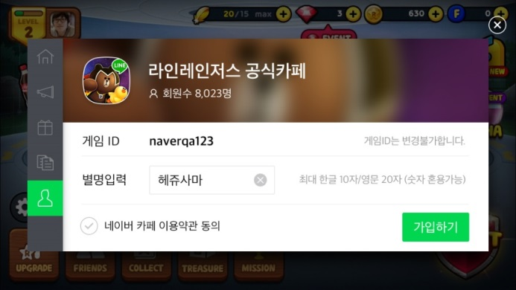
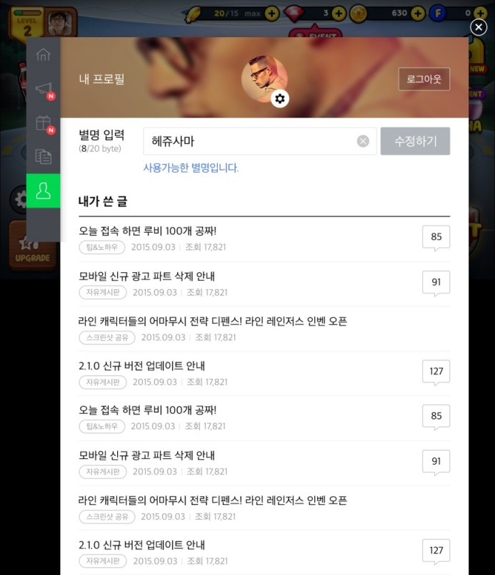
5. Tab > Join Community and Edit Profile
Only a “nickname” is required to join a community; it allows users to easily join without providing additional personal information
Users can edit their nicknames or view the 10 most recent posts in My Profile after signup

Slide 11
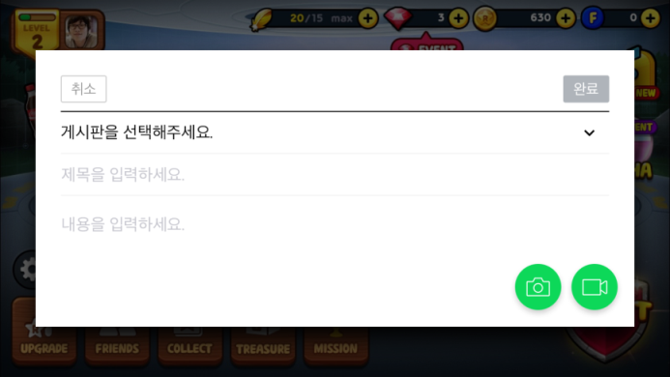
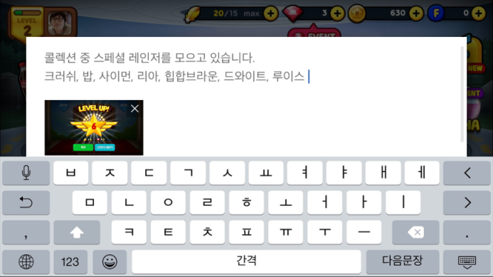
6. Menu > Composing
Selecting a menu and then entering a subject and body
Only image or video attachment available

Slide 12

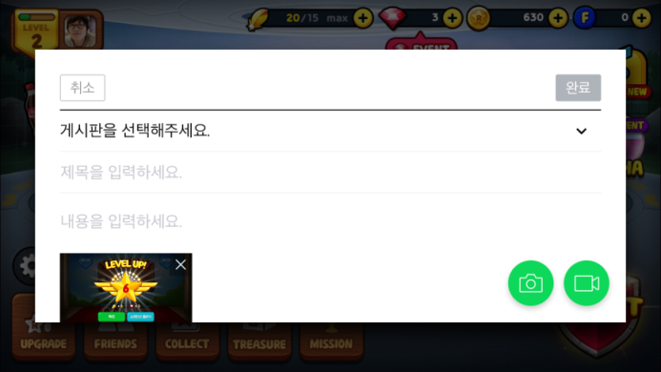
6. Menu > Direct Uploads
Direct uploads of screenshots or videos

Slide 13
7. Support Details
Currently, only landscape orientation is supported. (Portrait orientation will also be supported.)
Android, iOS, Unity, and Cocos2d-x are currently supported.
Posts written within SDK are also published in the corresponding NAVER Cafe community.
Users must use NAVER Login to join the NAVER Cafe community.

Slide 14
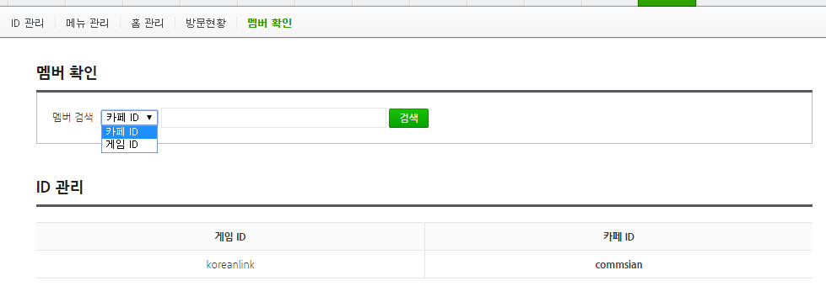
8. Others
We offer the ID mapping functionality between game IDs and NAVER Cafe IDs to the SDK partners. ① You can use this functionality to identify event winners, etc. ② In order to use this functionality, you should send users’ game IDs to NAVER. ③ Game IDs are considered personally identifiable information. Therefore, you must inform users of the recipient of data, data to be shared, the purposes of sharing, and the period of data retention, and receive prior consent from your users, which is required by laws regarding privacy data collected by third parties. ④ It is recommended to write a privacy notice as simple as possible so that you can reduce user resistance. Here is our example: - Example: “Your game ID will be submitted to the NAVER Cafe community for use of the NAVER Cafe services (e.g. free giveaways offered by community managers), and submitted data will remain stored until you delete your account from the community or the community is closed.”
HTTPS is used for communication between SDK and the NAVER Cafe API.

Slide 15
- End of Document - Thank you -

